Slide 1
biopsychology
PSY. 101
Prof: Dr. Doe Buchli
Fall 2016
Mercer University

Slide 2

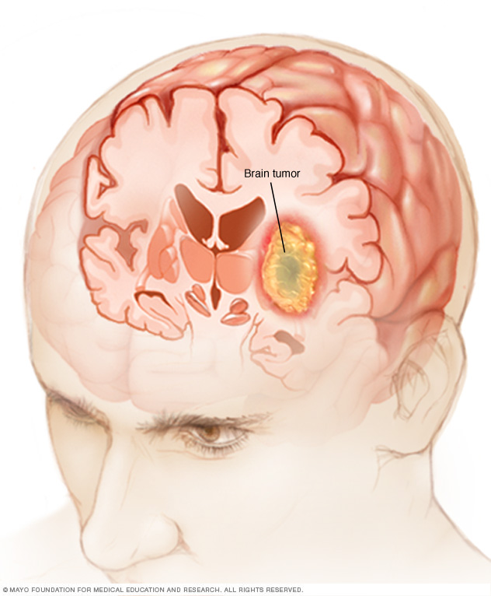
Notes:
Everything psychological is simultaneously biological

Slide 3
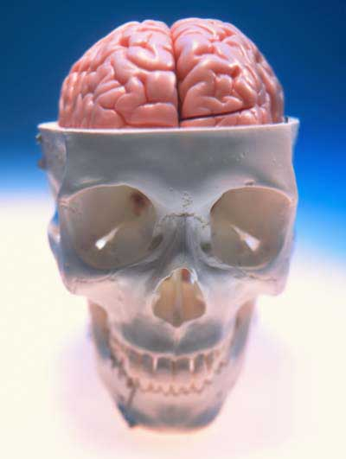
Today’s search for the biology of the self: biological psychology
Biological psychology includes neuroscience, behavior genetics, neuropsychology, and evolutionary psychology.
All of these subspecialties explore different aspects of: how the nature of mind and behavior is rooted in our biological heritage.

Slide 4
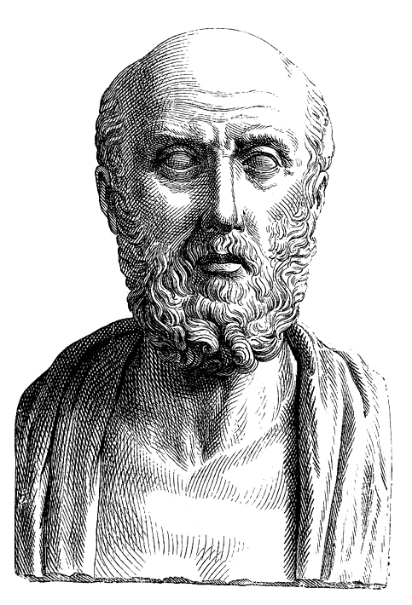
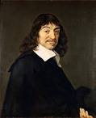
Historical Foundations
Do mental experiences arise in the heart (e.g. Aristotle ca. 384 BC) or brain (e.g. Hippocrates ca. 460 BC)?
How can a physical substance (brain/body) give rise to mental experiences? = MIND–BODY PROBLEM
- Dualism – mind and body are separate substances (e.g. Descartes)
- Dual-aspect theory – mind and body are two levels of explanation of the same thing (e.g. like wave-particle duality)
Reductionism – mind eventually explained solely in terms of physical/biological theory
Notes:
DUALISM – mind and body are completely separate entities, made up of completely different substances, although they may interact. Descartes believed the mind was nonphysical and immortal (soul), while the body was physical and mortal. According to Descartes, the site at which the mind interacts with the body is the pineal gland (center of brain). Stimulation of sense organs caused vibration, that would be picked up by the pineal gland and this would create a sense of awareness
DUAL-ASPECT THEORY – Spinoza argued that mind and body are two different levels of explanation for the same thing. Analogous to wave-particle theory in physics. In electron can be described as both a wave and a particle.
REDUCTIONISM – all of cognition can be explained in terms of or reduced to biology. All of psych will eventually be reduced to bio. Think cognitive psychology is redundant
In the 17th century, scientists believed all fire contained a substance called plogiston. Eventually chemists figured out how elements combine with oxygen to create fire, replaced phlogiston theory. Reductionists believe that mind-based concepts and consciousness will have same status as phlogiston in the future. Reductionists argue that emotions still feel like emotions, even if we understand the neural basis, so cognition will never be fully replaced as a subject of inquiry.

Slide 5
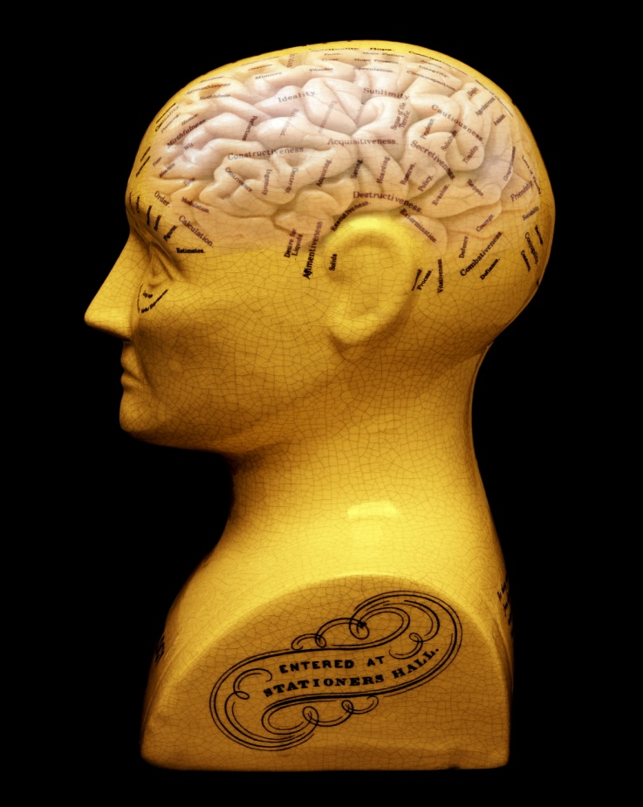
Phrenology (Franz Joseph Gall,1796)
Different parts of cortex serve different functions
Differences in personality traits manifest in differences in cortical size and bumps on skull
Crude division of psychological traits (e.g. "love of animals") and not grounded in science
Mark Sykes/Science Photo Library
Notes:
PHRENOLOGY – the failed idea that differences in cognition can be mapped on to differences in skull shape. Conceptualized by Gall and Spurzheim.
Has 2 key assumptions:
Different areas of the brain perform different functions and are associated with different behaviors
Size of these regions produce distortions/proctuberances in the skull that corrospond with individual differences in personality and cognitive function

Slide 6
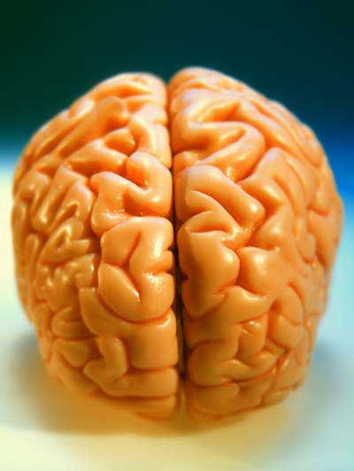
The Human Brain
Weighs between 3 and 4 pounds
Is roughly the size of a melon
Estimated to contain a trillion nerve cells, each of which is connected to 10,000 or so others
Total of ten million, billion connections
Is it possible to ‘understand’ the brain?
“If the human brain were so simple that we could understand it, we would be so simple that we couldn’t.”
–Emerson M. Pugh
…but we can try.

Slide 7
The Neuron

Slide 8
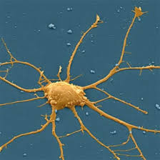
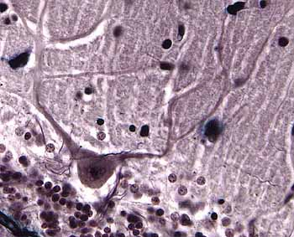
NEURON
GLIAL CELL
Notes:
Neurons are responsible for information transmission throughout the nervous system
Receiving, integrating and transmitting information
Glial cells do not directly transmit information, but instead support neurons in their work by disposing of waste products of neurons, keeping their chemical environment stable by providing nutrients and insulating the neuron
Proportion of glial cells greater the more intelligent you are; Einstein had same number and size of neurons but far more glial cells

Slide 9

STRUCTURE OF THE NEURON
Notes:
(^ IMPORTANT TO REMEMBER)
Dendrites are the fibers that project out of the cell body, receiving information from other neurons
The cell body contains the nucleus of the cell and other biological machinery to keep the cell alive
The axon transmits messages through the neuron. (Can be quite long. E.g. Brain transmit messages to muscles of legs)
The axon terminals are at the end of the axon and send messages to a different neuron
Myelin sheath – insulator. Signal is transmitted faster
Shwann cell – produces myelin
Node of ranvier – bounces signal across so signal isn’t transmitted too fast
Demyelinationof motor neurons result in say (muscle, memory loss)

Slide 10
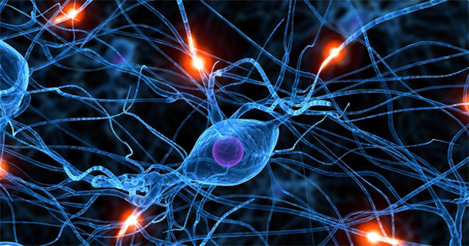
HOW NEURONS COMMUNICATE

Slide 11
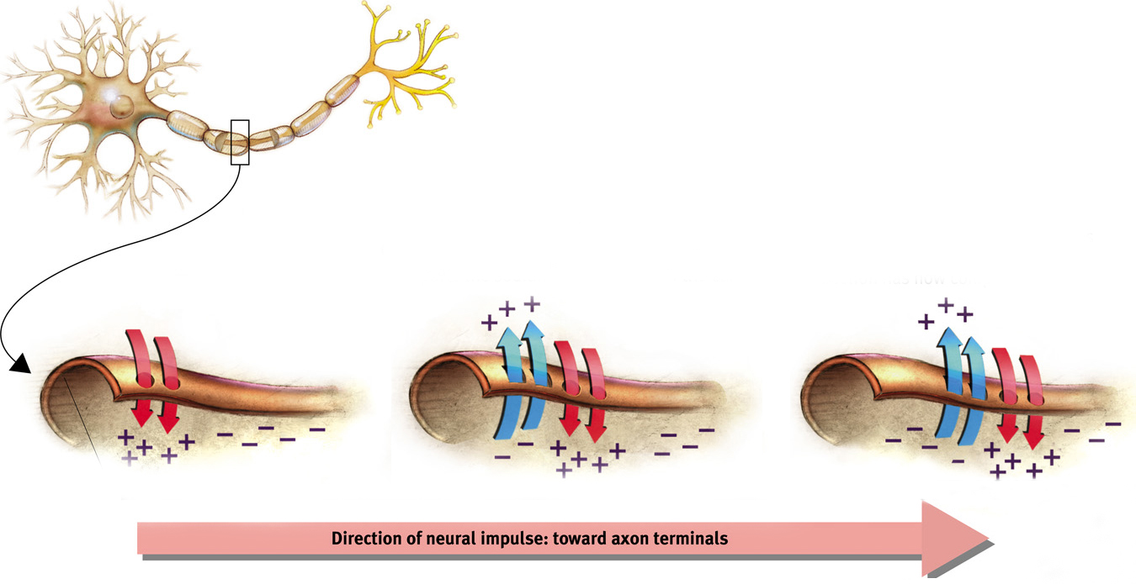
Action potential: a neural impulse that travels down an axon like a wave
Notes:
Automatic animation.
Note: with both the stadium example and the action potential example, no physical object actually flows in any direction when the wave flows.
The action potential is the area that is briefly charged by the net intake of positive ions; this is the traveling “electrical charge” created when channels in the cell membrane quickly allow positive ions in, and then more slowly pump the ions out again as the wave moves on.
The fans in the stadium create the wave by standing up briefly; the cell membrane creates a wave by pumping positive ions in briefly. This could be the subject of a demonstration in class.

Slide 12
When does the cell send the action potential?... when it reaches a threshold
How neurons communicate (with each other):
The neuron receives signals from other neurons; some are telling it to fire and some are telling it not to fire.
When the threshold is reached, the action potential starts moving.
Like a gun, it either fires or it doesn’t; more stimulation does nothing.
This is known as the “all-or-none” response.
The action potential travels down the axon from the cell body to the terminal branches.
The signal is transmitted to another cell. However, the message must find a way to cross a gap between cells. This gap is also called the synapse.
The threshold is reached when excitatory (“Fire!”) signals outweigh the inhibitory (“Don’t fire!”) signals by a certain amount.
Notes:
Click to show each stage in the path.
If signals only have one level of intensity, then why does a punch hurt more than a tap? Because in the case of the punch, more neurons are firing.
Increasing the level of stimulation will not increase an action potential’s intensity; more neurons fire with a more intense stimulus, and fire more often. Action potential’s strength or speed does not change
Neurotransmitters – chemical messengers. Next slide

Slide 13
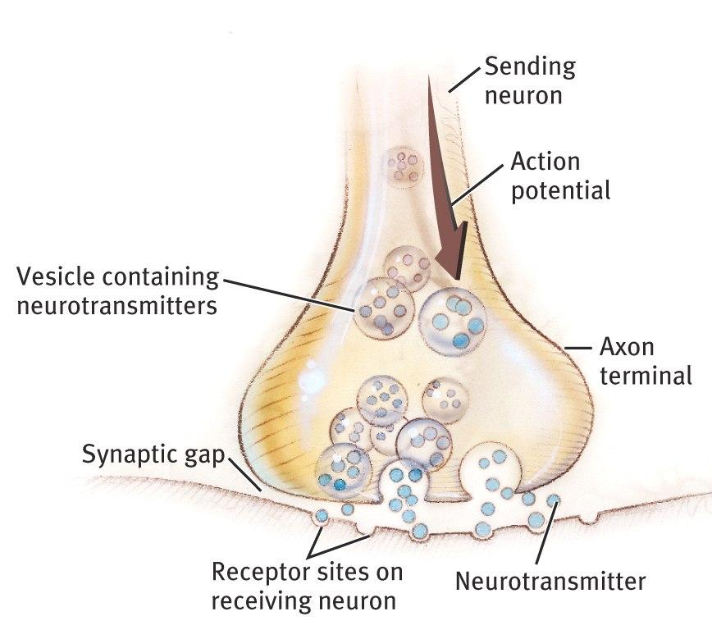
The Synapse
The synapse is a junction between the axon tip of the sending neuron and the dendrite or cell body of the receiving neuron.
The synapse is also known as the “synaptic junction” or “synaptic gap.”

Slide 14
Neurotransmitters
Neurotransmitters are chemicals used to send a signal across the synaptic gap.
Notes:
No animation.
Neurotransmitters are released from the sending neuron and stimulate receptor sites on the receiving neuron. These are the signals telling the receiving cell whether or not to fire the next action potential.

Slide 15
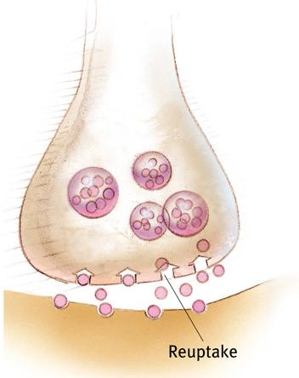
Reuptake: Recycling Neurotransmitters [NTs]
Reuptake:
After the neurotransmitters stimulate the receptors on the receiving neuron, the chemicals are taken back up into the sending neuron to be used again.
Notes:
No animation.
Reuptake ends the transmission of the signal.
Medications which inhibit this reuptake process help ensure that the signal gets transmitted. SSRIs help reduce depression by increasing serotonin levels at the synapse this way, and most ADHD medications such as Ritalin work by blocking the transport of dopamine back into the sending neuron.

Slide 16
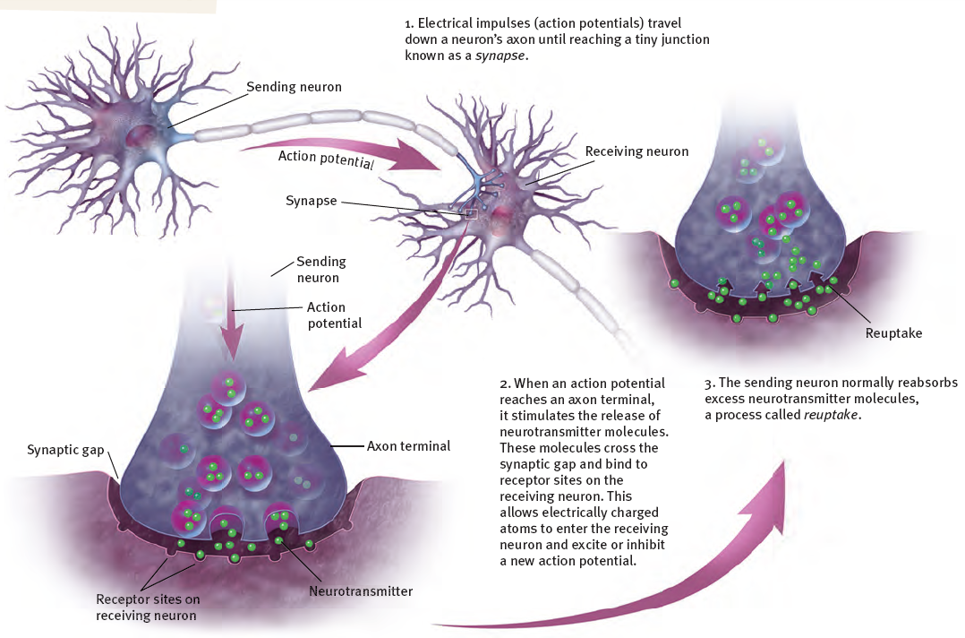

Slide 17
Neurotransmitters, drugs, and poisons

Slide 18
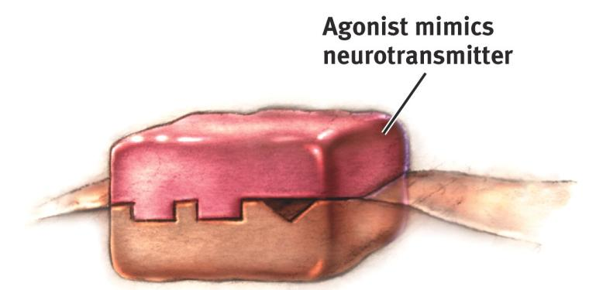
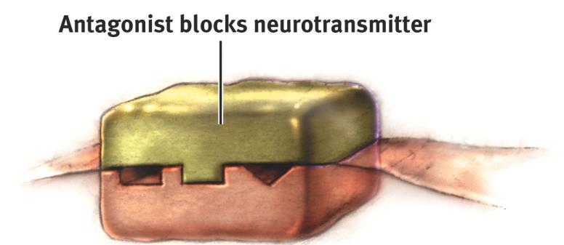
Agonists
Antagonists
Increase a neurotransmitter’s action
Increase production or release
Block reuptake – why?
Mimic neurotransmitter and bind to receptor
Decrease a neurotransmitter’s action
Blocking production or release
Block receptor sites

Slide 19
Neurotransmitters
1. Acetylcholine (ACh) is involved in both learning and memory and muscle movement
2. Dopmaine impacts our arousal and mood states, thought processes, and physical movement
3. Serotonin and norepinephrine are neurotransmitters involved in levels of arousal and mood, and play a major role in mood disorders such as depression
4. GABA is the main inhibitory neurotransmitter in the nervous system; glutamate is the main excitatory neurotransmitter
5. Endorphins are a group of neurotransmitters that are involved in pain perception and relief

Slide 20
Acetylcholine (ACh)
Botulinum poison (botulin) is an antagonist that blocks the release of ACh at muscle junctures, leading to paralysis and even death
Curare is an antagonist that paralyzes the body by occupying the receptor sites for ACh, thereby preventing ACh from getting in and carrying its message to a neuron
Black widow spider venom is an agonist for Ach, causing the continuous release of ACh, flooding the synapse

Slide 21
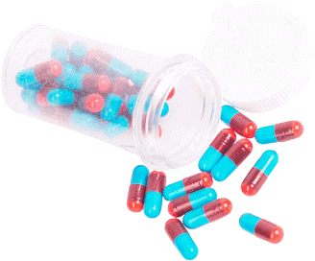
Dopamine
Low levels are associated with Parkinson’s disease, and excessively high levels are associated with schizophrenia
L-Dopa is an agonist that increases production of dopamine
Anti-psychotic drugs are antagonists that block the receptor sites for dopamine so that this neurotransmitter cannot send its messages
Amphetamine acts as an agonist by stimulating the release of dopamine from axon terminals
Cocaine is an agonist that blocks the re-uptake of dopamine

Slide 22
Serotonin and Norepinephrine
Some antidepressant drugs work by blocking the reuptake of serotonin and norepinephine
Anti-depressant drugs like Prozac, Paxil, and Zoloft are selective serotonin reuptake inhibitors

Slide 23
GABA and Glutamate
Anti-anxiety drugs are agonists for GABA
Lack of GABA may contribute to epilepsy, a brain disorder resulting in uncontrolled movement and convulsions
Glutamate is involved in memory storage and pain perception.
Excessive glutamate can lead to neuron death; deficient glutamate has been proposed to explain schizophrenia

Slide 24
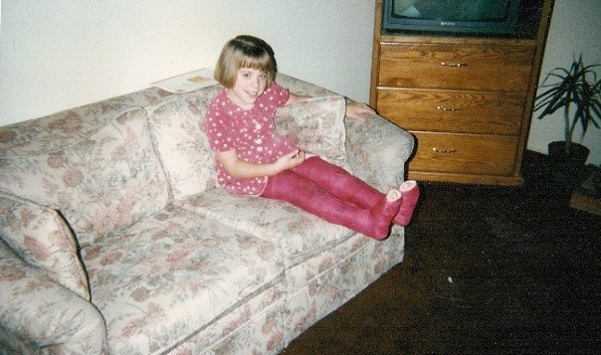
GABA and Spastic Cerebral Palsy
Dr. Buchli, age 9

Slide 25
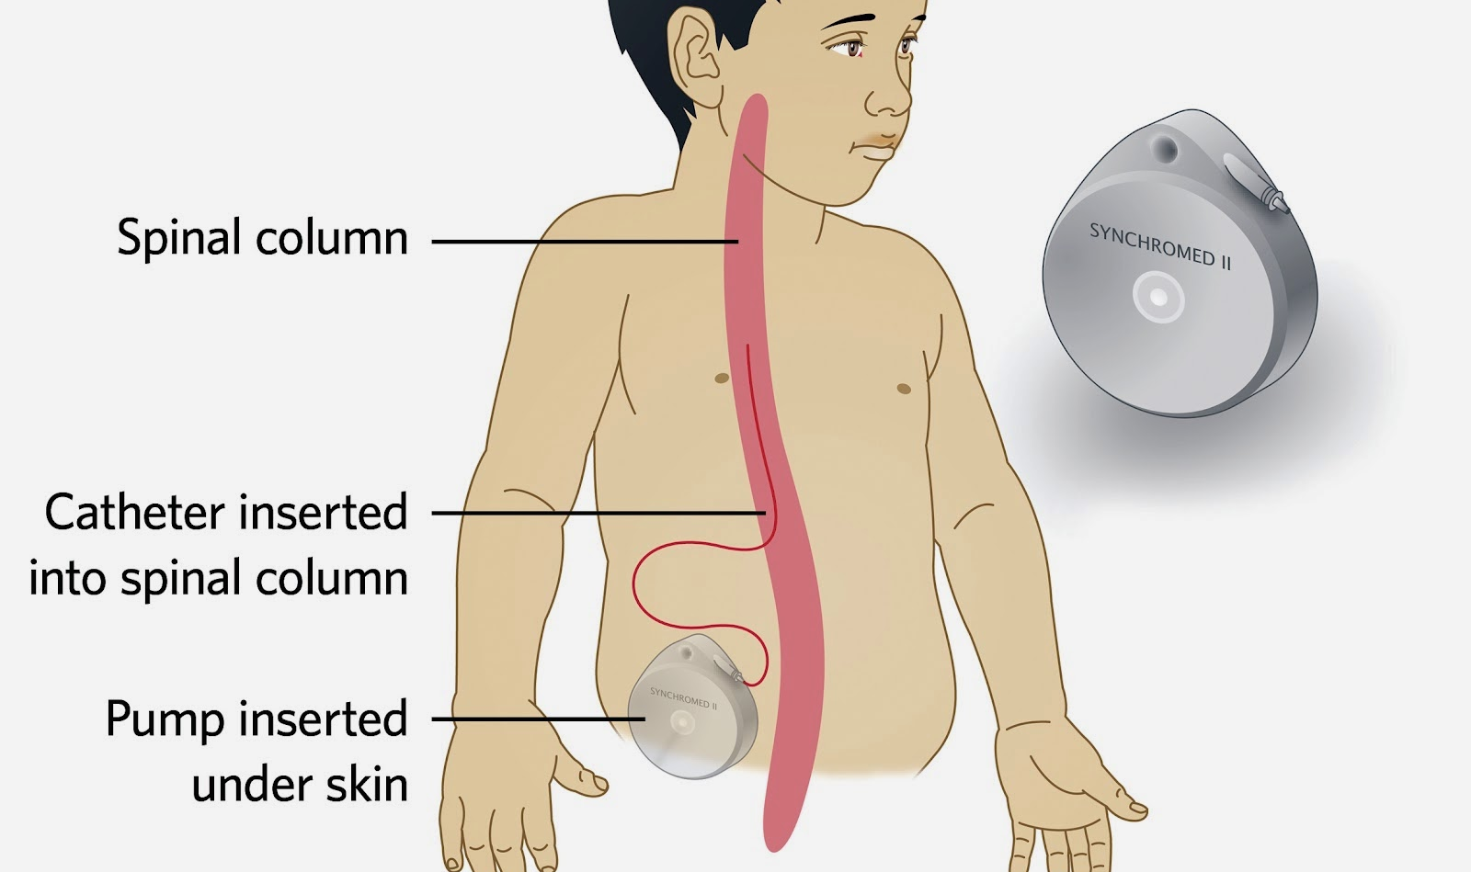
GABA and Spastic Cerebral Palsy
Notes:
GABA agonist

Slide 26
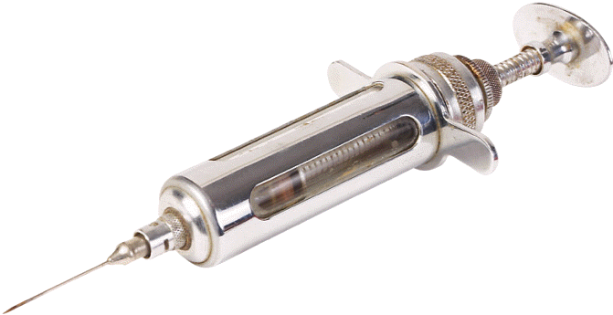
Endorphins
Morphine and heroin are agonists that bind to receptor sites, thereby increasing endorphin activity

Slide 27
The brain

Slide 28
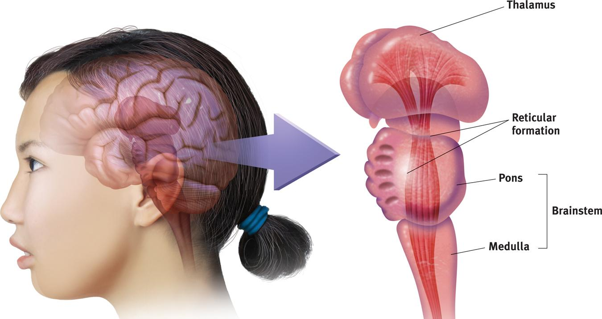
The Brainstem: Pons and Medulla
The medulla controls the most basic functions such as heartbeat and breathing.
Someone with total brain damage above the medulla could still breathe independently, but someone with damage in this area could not.
The pons helps coordinate automatic and unconscious movements.
Notes:
Click to reveal second bullet.
The brain’s innermost region begins where the spinal cord enters the skull. Christopher Reeve (1952-2004; an image of him here might work well), an actor in Superman movies and Smallville, couldn’t breathe on his own after a horse riding accident broke his spine at the level of the medulla.

Slide 29
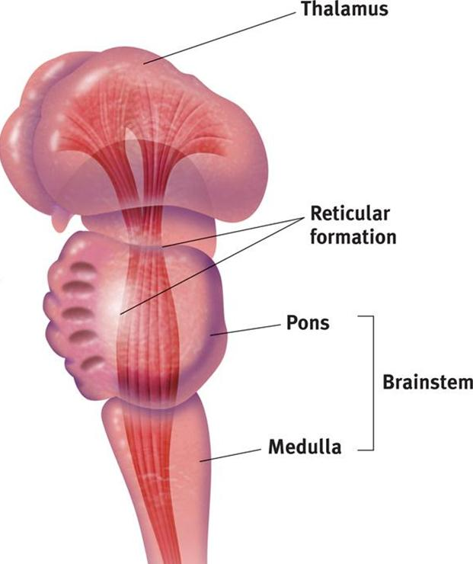
The Thalamus (“Inner Chamber”)
The thalamus is the “sensory switchboard” or “router.”
All sensory messages, except smell, are routed through the thalamus on the way to the cortex (higher, outer brain).
The thalamus also sends messages from the cortex to the medulla and cerebellum.
Notes:
Click to reveal bullets.
The book says “switchboard,” but perhaps it’s time to upgrade the term to “router.”
Damage to the thalamus can cause blindness and other loss of the senses, even if the sensory organ is fine.
However, damage to the thalamus could not hurt your sense of smell, which bypasses the thalamus and goes straight to the olfactory bulb in the brain.

Slide 30
Reticular (“Netlike”) Formation
The reticular formation is a nerve network in the brainstem.
It enables alertness, (arousal) from coma to wide awake (as demonstrated in the cat experiments).
It also filters incoming sensory information.
Notes:
Click to reveal bullets.
Additional information/lecture material:
The structure of the reticular formation: this network of neurons branches from the spinal cord up into the thalamus. I have added two lines to the picture to indicate this.
How do we know about arousal? In the cat experiments, researchers stimulated the reticular formation in order to make a sleeping cat pop awake. Similarly, cutting the reticular formation made a cat lapse into a permanent coma.
About the filtering: it could be said that the reticular formation controls selective awareness; it ‘selects’ which incoming information to send to other brain areas. This enables us to follow a conversation in a crowd, i.e. to select a “signal” out of sensory “noise.”

Slide 31
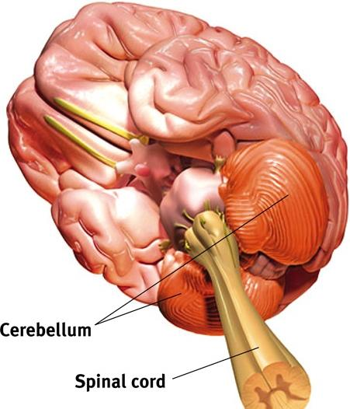
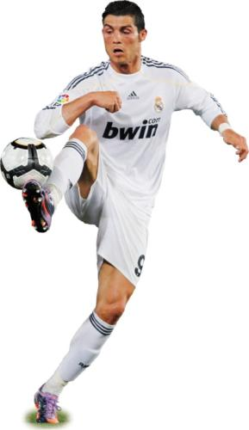
Cerebellum (“little brain”)
The cerebellum helps coordinate voluntary movement such as playing a sport.
The cerebellum has many other functions, including enabling nonverbal learning and memory.
Notes:
Click to reveal bullets.
The cerebellum is located in two parts, behind the pons and below the back of the brain.
The cerebellum also is the area where implicit memories and conditioning are stored. It also helps us judge time, modulate emotions, and integrate multiple sources of sensory input.
Implicit memory

Slide 32
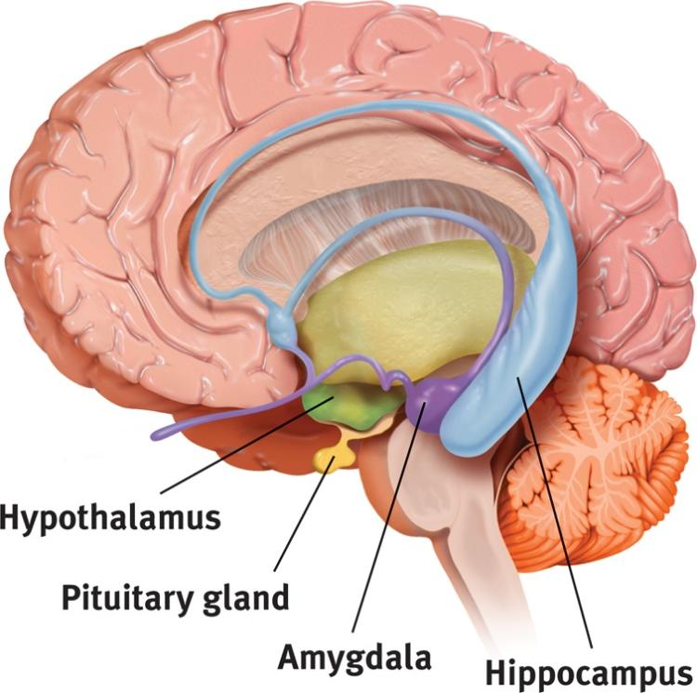

The Limbic (“Border”) System
The limbic system coordinates:
emotions such as fear and aggression.
basic drives such as hunger and sex.
the formation of episodic memories.
The hippocampus (“seahorse”)
processes conscious, episodic memories.
works with the amygdala to form emotionally charged memories.
The Amygdala (“almond”)
consists of two lima bean- sized neural clusters.
helps process emotions, especially fear and aggression.
Notes:
The limbic system is located on the “border”/limbus between the brainstem and cortex; it is between the least complex and most advanced brain structures and between the cerebral hemispheres.
The hippocampus is one of the few places in the brain in which neurogenesis is known to take place.
Stimulating different parts of the amygdala triggers different versions of the defensive, self-protective emotions; one part increases aggressive reactions, while another increases fearful withdrawal. Destruction of part of the amygdala can apparently eliminate both emotions.
Note: aggression and fear reactions involve networks across the brain, and these reactions can be stimulated elsewhere.
The pituitary gland is in the text image, but I faded and shrank the label because it is not really part of the limbic system; I’ll restore it when talking about the hypothalamus.

Slide 33

The Amygdala
Electrical stimulation of a cat’s amygdala provokes aggressive reactions.
If you move the electrode very slightly and cage the cat with a mouse, the cat will cower in terror.
Notes:
Click to reveal bullets.

Slide 34
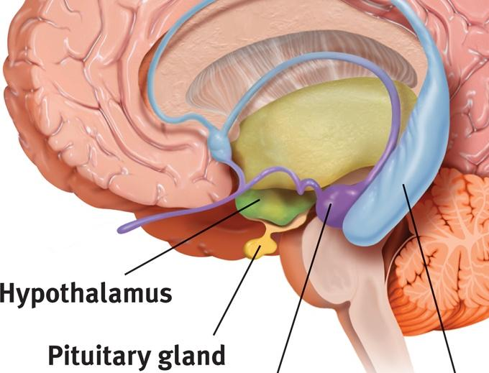
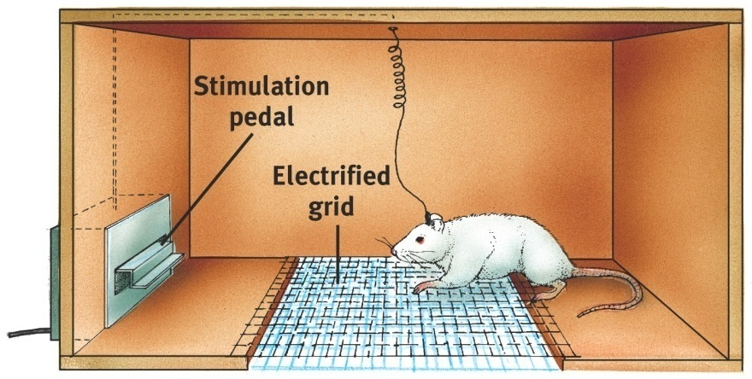
The Hypothalamus:
lies below (“hypo”) the thalamus.
regulates body temperature and ensures adequate food and water intake (homeostasis), and is involved in sex drive.
directs the endocrine system via messages to the pituitary gland.
Thalamus
The Hypothalamus as a Reward Center
Riddle: Why did the rat cross the grid?
Why did the rat want to get to the other side?
Pushing the pedal that stimulated the electrode placed in the hypothalamus was much more rewarding than food pellets.
Notes:
If you lesion one part of the hypothalamus of a rat, it stops eating; lesion another part and it hardly stops eating.
Click to reveal ‘Hypothalamus Reward Center’ riddle. Click again for answer.
Instructor: After addressing the riddle on the slide, but before adding the additional lecture material below, consider throwing out a question, “So where on this screen is the reward center?. Is it here, (point to the cage), the place to go to get rewards? Oh, it’s up here? (point to the hypothalamus).” [This is where you could note, as below, that there are other reward centers…]
Additional lecture material:
There are other reward centers, including an area near the hypothalamus, the nucleus accumbens.
Many of these areas rely on dopamine, which may be why people with low dopamine (ADHD) don’t learn well from rewards, and why people who crave dopamine (ADHD, addicts, young teens, and those with reward deficiency syndrome) are reckless in their search for it, maybe even crossing an electrified grid like the rat in the illustration.

Slide 35
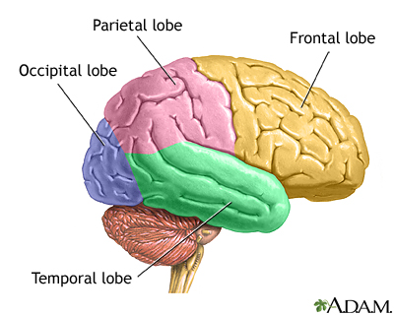
The Cerebral Cortex The lobes consist of:
outer grey “bark” structure that is wrinkled in order to create more surface area for 20+ billion neurons.
inner white stuff—axons linking parts of the brain.
180+ billion glial cells, which feed and protect neurons and assist neural transmission.
Notes:
The orange area is the cerebellum.

Slide 36
The Lobes of the Cerebral Cortex: Preview
involved in speaking and muscle movements and in making plans and judgments
Frontal Lobes
Parietal Lobes
Occipital Lobes
Temporal Lobes
include the sensory cortex
include the visual areas; they receive visual information from the opposite visual field
include the auditory processing areas
Notes:
Frontal lobe also involved with language. Broca’s area
Parietal lobes – receives senses, especially temperature, touch, taste
Occipital lobes – contralateral processing
Temporal lobes – also where hippocampus is located. Wernicke’s area also there

Slide 37
Research Methods

Slide 38
Investigating the Brain and Mind:
Strategies for finding out what is different about the mind when part of the brain isn’t working normally:
case studies of accidents (e.g. Phineas Gage)
case studies of split-brain patients (corpus callosum cut to stop seizures)
lesioning brain parts in animals to find out what happens
chemically numbing, magnetically deactivating, or electrically stimulating parts of the brain
How did we move beyond phrenology and get inside the skull and under the “bumps”?
by finding what happens when part of the brain is damaged or otherwise unable to work properly
by looking at the structure and activity of the brain: CAT, MRI, fMRI, and PET scans
Notes:
Questions about parts of the brain:
Do you think that the brain is the sum of its parts, or is the brain actually about the way they are connected?
What do you think might happen if a particular area of the brain was stimulated?
What do you think might happen if a particular area of the brain was damaged or not working well?
Weaber test? Injecting chemical agent to “turn off” an area of the brain

Slide 39
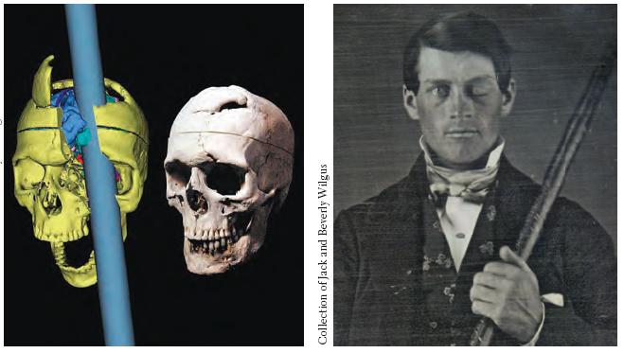
Studying cases of brain damage
When a stroke or injury damages part of the brain, we have a chance to see the impact on the mind.
Notes:
No animation.
Instructor: Some examples of brain areas we learned about thanks to patients with brain damage: the frontal lobes (as with Phineas Gage, pictured here), Broca’s area, and Wernicke’s area. Broca’s area is named after French physician Pierre Paul Broca (1824-1880) . Wernicke’s area was named after German physician Carl Wernicke (1848-1905).

Slide 40
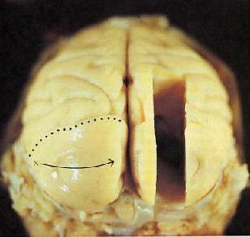
Intentional brain damage:
Lesions (surgical destruction of brain tissue)
performed on animals
has yielded some insights, especially about less complex brain structures
no longer necessary, as we now can chemically or magnetically deactivate brain areas to get similar information
Notes:
Click to reveal bullets.

Slide 41

We can stimulate parts of the brain to see what happens
Parts of the brain, and even neurons, can be stimulated electrically, chemically, or magnetically.
This can result in behaviors such as giggling, head turning, or simulated vivid recall.
Researchers can see which neurons or neural networks fire in conjunction with certain mental experiences, and even specific concepts.
Notes:
Hopefully students will understand that brain stimulation is less dramatic than the use of a bolt of lighting; it involves only small electrodes. Although people feel like the stimulation of certain brain locations produces vivid memories, research has proven that this impression is false; the memories feel vivid, but are inaccurate.
Montreal procedure
Wilder Penfield

Slide 42
Issues in Neuro Methods
Spatial Resolution – How close in physical proximity you can get to the target brain area
Temporal Resolution – How close in time you can get to when the neurons fire
Invasiveness – The extent to which foreign substances are introduced to the body.
Cost – All are really expensive

Slide 43
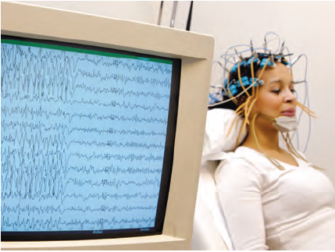
Electroencephalography (EEG)
Electrodes measure brain’s electrical activity
Measures large assemblies of neurons firing together across many trials
Useful for studying seizures and sleep
Excellent temporal resolution, but poor spatial resultion

Slide 44
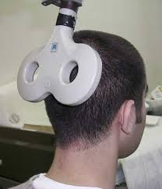
Transcranial Magnetic Stimulation (TMS)
Sends electrical impulses to disrupt communication between neurons
Used for…
Direct testing of function
Treatment for some neurological & psychological conditions

Slide 45
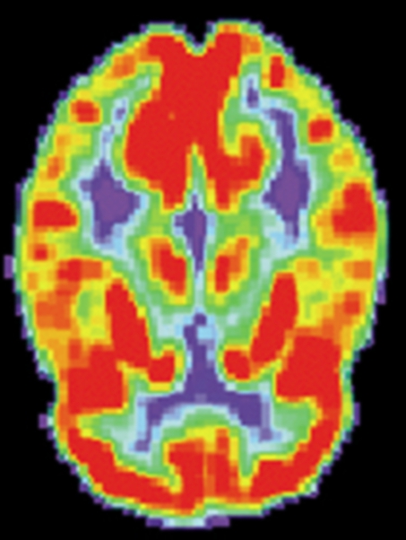
Positron Emission Tomography (PET)
Patients injected with isotopes designed to tag specific chemicals (e.g., glucose)
Isotopes emit positrons, which collide with electrons and release gamma rays
Detectors measure gamma rays and create image of brain as patient performs certain functions
Used for…
Revealing size, shape, & function of brain
Detecting damaged areas and diagnosing dementia

Slide 46
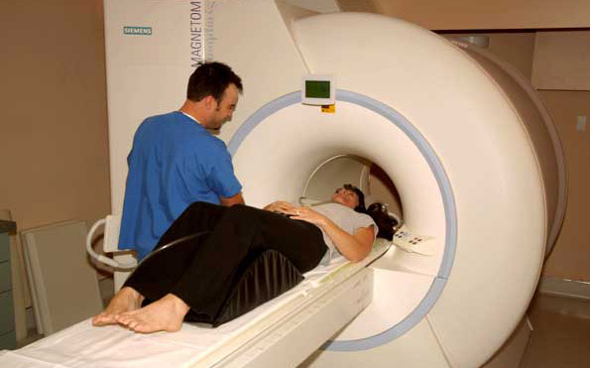
Magnetic Resonance Imaging (MRI)
Your brain’s atoms are spinning!
Magnetic pulse disrupts normal spinning
As atoms return to normal, they emit energy
Computer reads energy and creates an image
Used for revealing brain’s structure

Slide 47
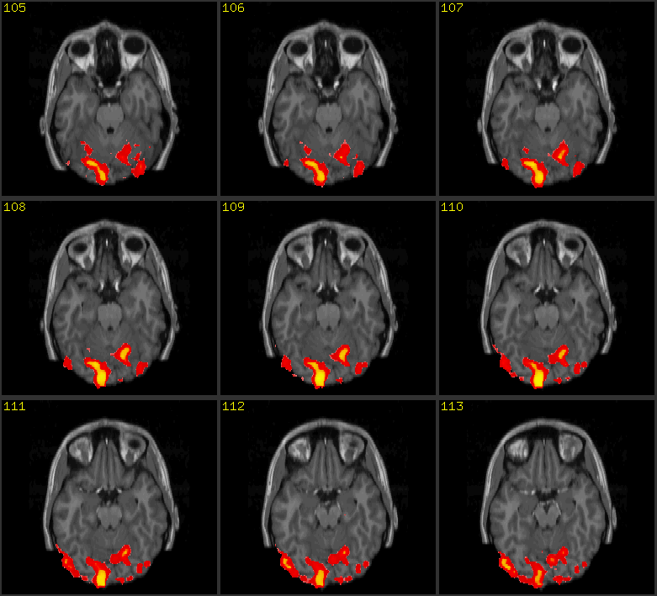
Functional MRI (fMRI)
Reveals brain activity rather than just structure
Compares successive MRI images taken a split second apart, and shows changes in the level of oxygen in bloodflow in the brain
Great for determining location; not as good at determining timing

Slide 48
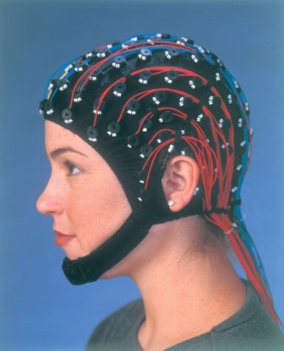
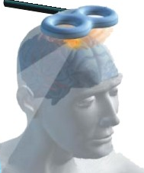
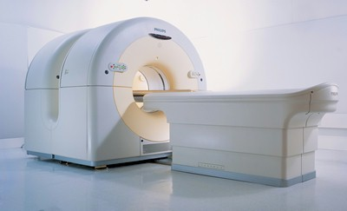
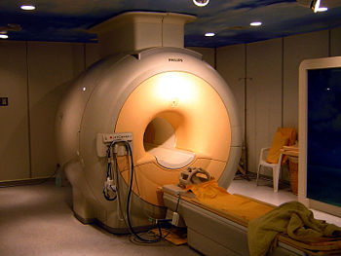
 | Device to record? | Temporal resolution? | Spatial resolution? | Invasiveness?
EEG |  | Excellent (millisecs) | Poor | Non-invasive
TMS |  | Excellent | Mediocre | Non-invasive
PET |  | Very poor (~30s-mins) | Excellent (~4mm) | Invasive
fMRI |  | Poor (seconds) | Excellent (~3-6mm) | Non-invasive

Slide 49
The Nervous System

Slide 50
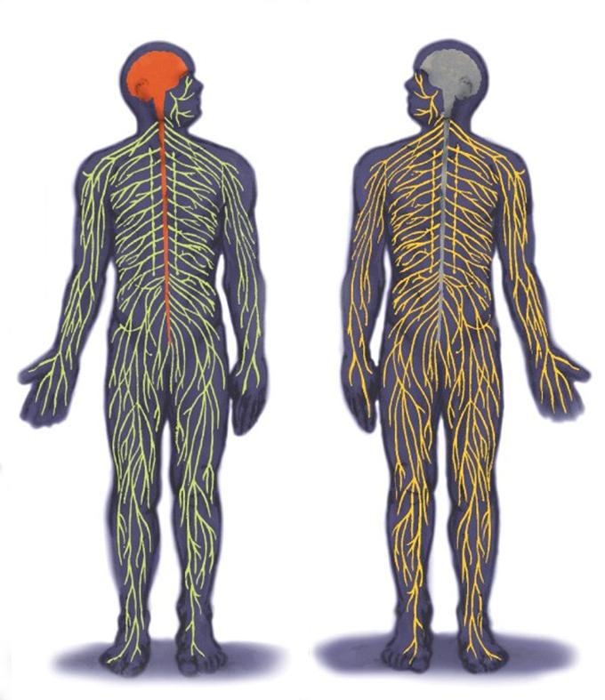
The Inner and Outer Parts of the Nervous System
The peripheral nervous system [PNS] consists of ‘the rest’ of the nervous system.
The PNS gathers and sends information to and from the rest of the body.
The central nervous system [CNS] consists of the brain and spinal cord.
The CNS makes decisions for the body.
Notes:
The descriptive text is color-coded to go with the part of the nervous system referred to in the diagram.
The image is from a previous version of the text.

Slide 51
Types of Neurons
Interneurons exist only in the central nervous system
Sensory neurons carry information to the central nervous system from sensory receptors in the eyes, muscles, and glands
Motor neurons carry movement commands from the central nervous system to the rest of the body

Slide 52
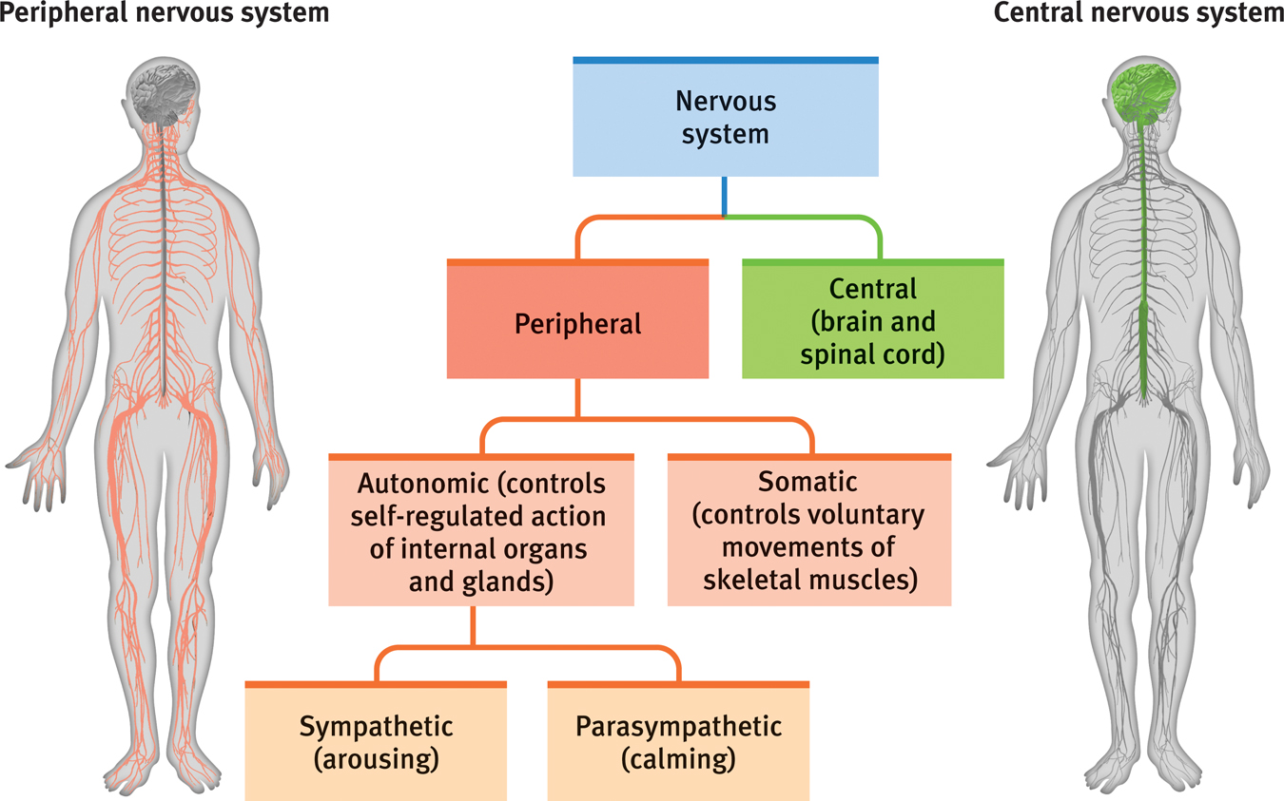
More Parts of the Nervous System
Notes:
Note that the autonomic, somatic, sympathetic, and parasympathetic branches of the nervous system are all part of the PNS. Nerves consist of neural “cables” containing many axons. Nerves consist of neural “cables” containing many axons. Nerves are part of the peripheral nervous system and connect muscles, glands, and sense organs to the central nervous system.

Slide 53
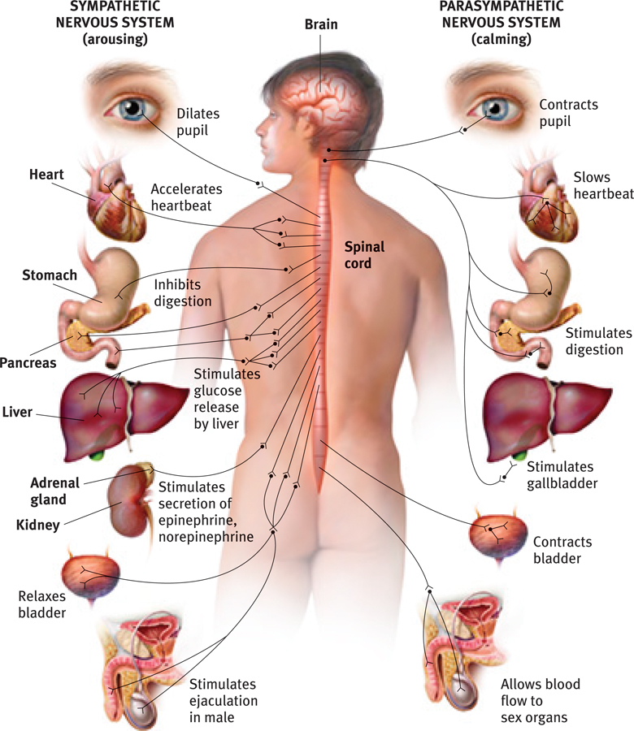
The Autonomic Nervous System:
The sympathetic NS arouses
(fight-or-flight) The parasympathetic NS calms
(rest and digest)
Notes:
1. Question to ask students: Why not just stay aroused all the time?...to allow the body to repair itself and regain energy from food.
2. Comment to students: note the sympathetic nervous system’s effect on the stomach and bladder., This helps us understand why “I was so upset that I wet my pants” or “I was so upset I threw up.” Now you can take these reports as a sign of strong activation of the sympathetic part of the autonomic nervous system.

Slide 54
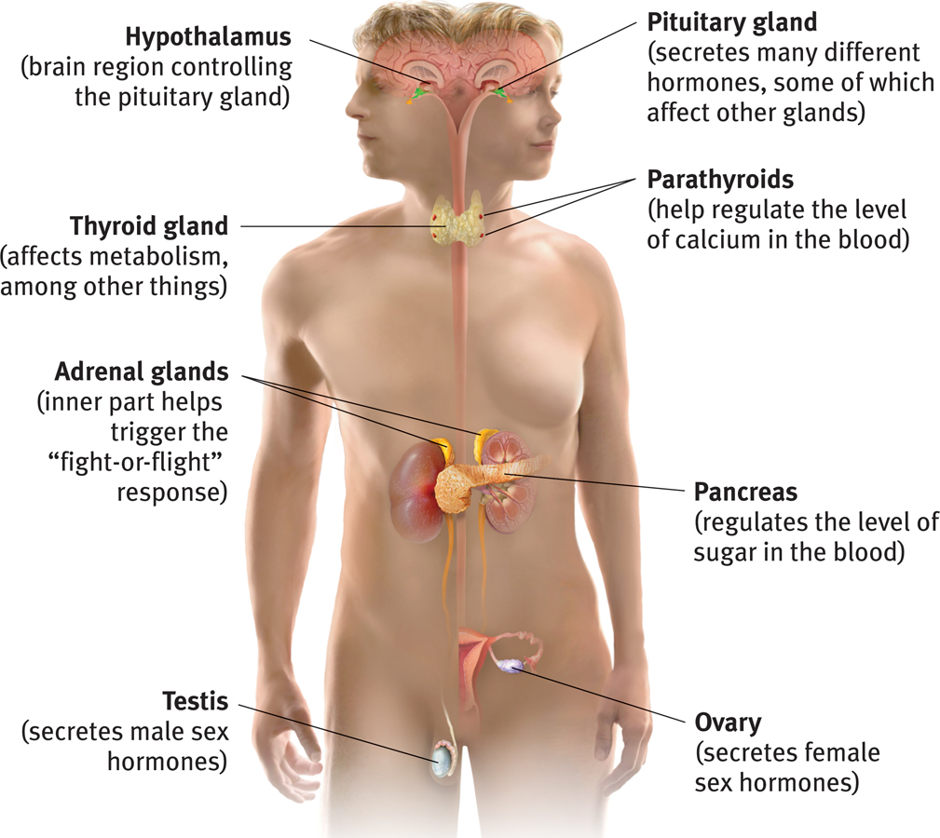
The Body’s “Slow but Sure” Endocrine Message System
The endocrine system sends molecules as messages, just like the nervous system, but it sends them through the bloodstream instead of across synapses.
These molecules, called hormones, are produced in various glands around the body.
The messages go to the brain and other tissues.
The endocrine system refers to a set of glands that produce chemical messengers called hormones.
Notes:
Slow but sure” endocrine system messages take longer to get to their location, but then the molecules hang around for a bit, so the effect of the “message” lasts longer. In neural communication, reuptake of the neurotransmitters sometimes prevents effective communication. (This is the real “chemical imbalance” treated by some medication: slowing reuptake.)

Slide 55
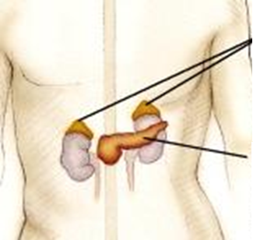
Adrenal Glands
produce hormones such as adrenaline/epinephrine, noradrenaline/norepinephrine, and cortisol.
Adrenal Glands
The sympathetic “fight or flight” nervous system responds to stress by sending a message to adrenal glands to release the hormones listed above.
Effect: increased heart rate, blood pressure, and blood sugar. These provide ENERGY for the fight or flight!
Pancreas
Notes:
The adrenal glands also produce cortisol; more about this when we talk about stress and health.

Slide 56
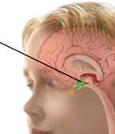
The Pituitary Gland
The pituitary gland is the “master gland” of the endocrine system.
It is controlled through the nervous system by the nearby brain area--the hypothalamus.
The pituitary gland produces hormones that regulate other glands such as the thyroid.
It also produces growth hormone (especially during sleep) and oxytocin, the “bonding” hormone.
Pituitary gland

